Slide 1
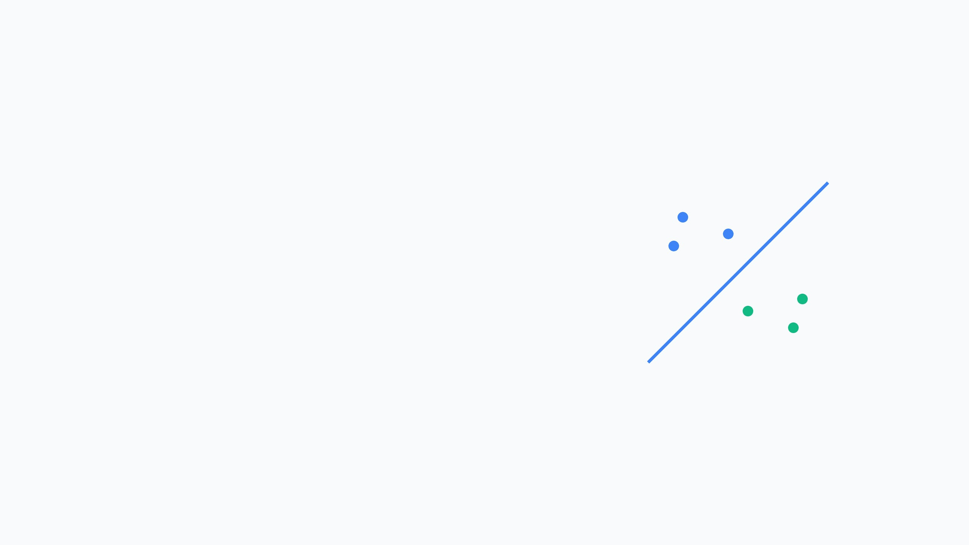
Support Vector Machines (SVM)
A Comprehensive Guide to Geometric Intuition and Mathematical Foundations
Presented by: Miraj Bhandari

Slide 2



Introduction to SVM
Powerful Supervised Learning
SVM is a versatile algorithm for both Classification (SVC) and Regression (SVR), robust in high-dimensional spaces.
Machine Learning
Beyond Logistic Regression
Pattern Recognition
Rather than any separator, SVM finds the Optimal Hyperplane for stronger confidence in predictions.
Optimal Decision Boundary
SVM finds a dividing line that separates the classes as clearly as possible by leaving the biggest gap between them.

Slide 3

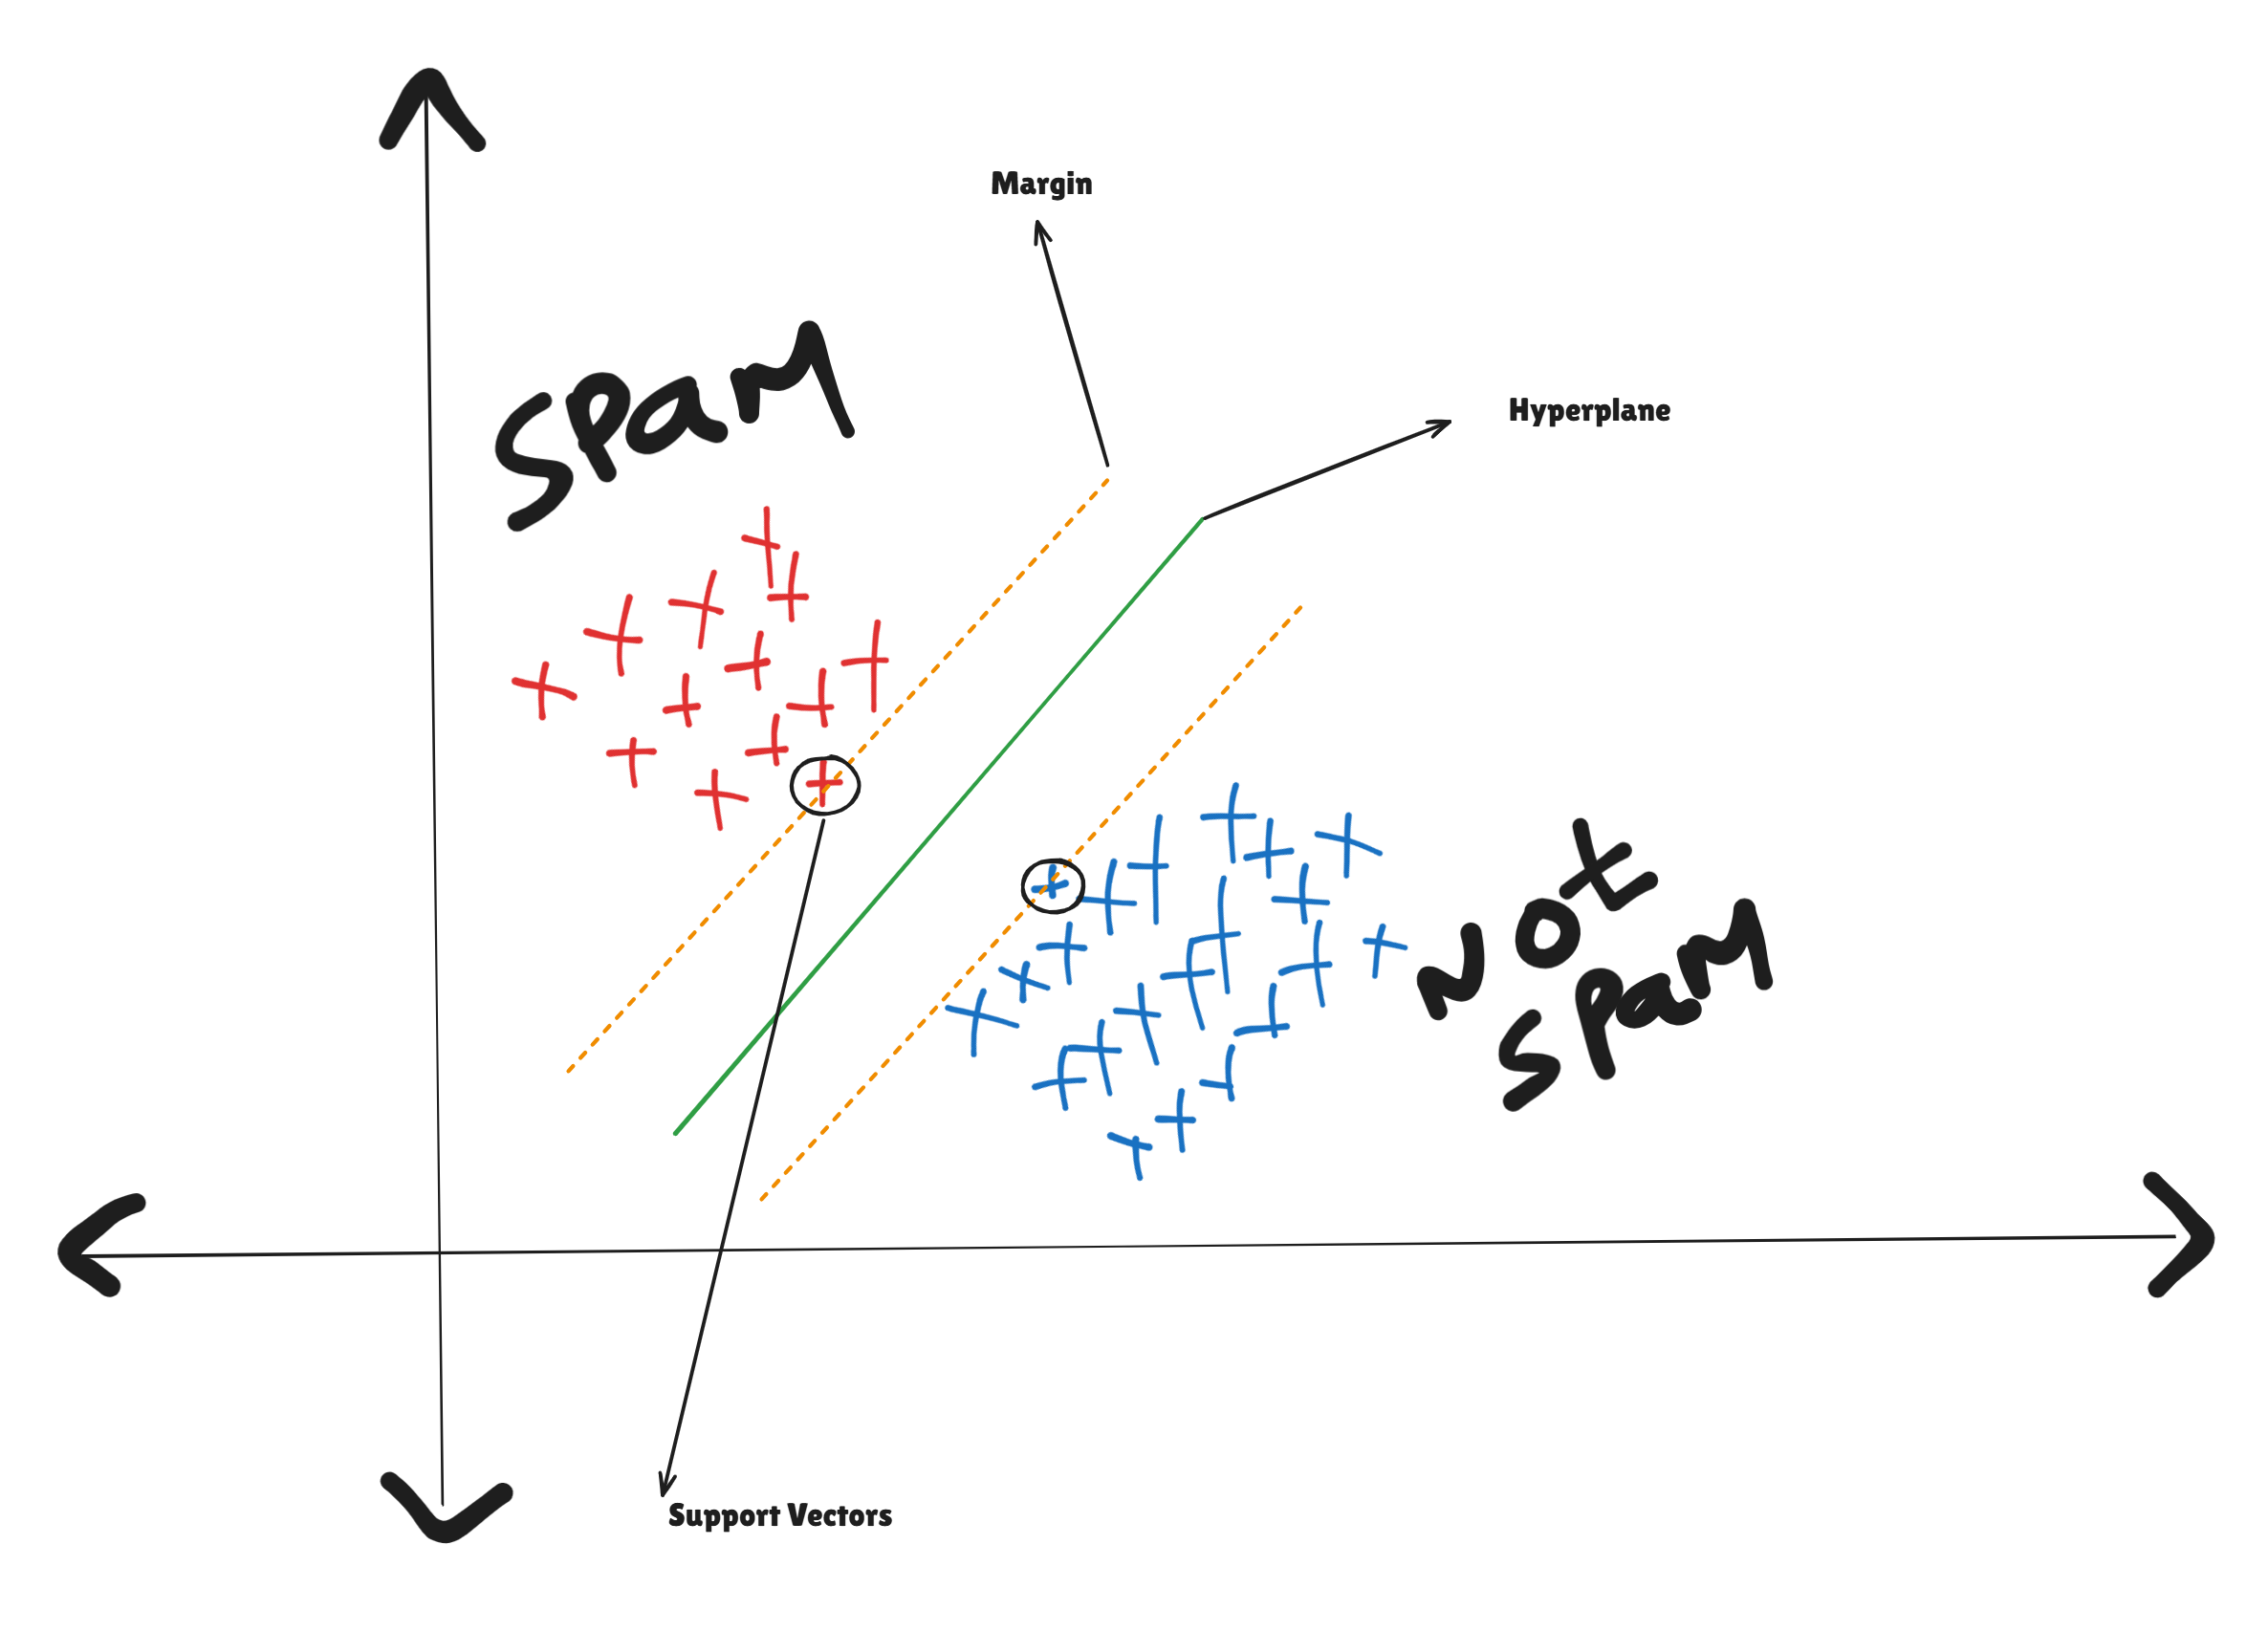
Key Geometric Components
Hyperplane
Marginal Planes
The primary decision boundary separating classes (a line in 2D, a plane in 3D).
Two parallel boundaries on either side of the hyperplane that pass through the closest data points.
Support Vectors
Maximum Margin
The critical data points lying exactly on the marginal planes that define the hyperplane's position.
The distance between marginal planes; maximizing this distance ensures better generalization for new data.

Slide 4
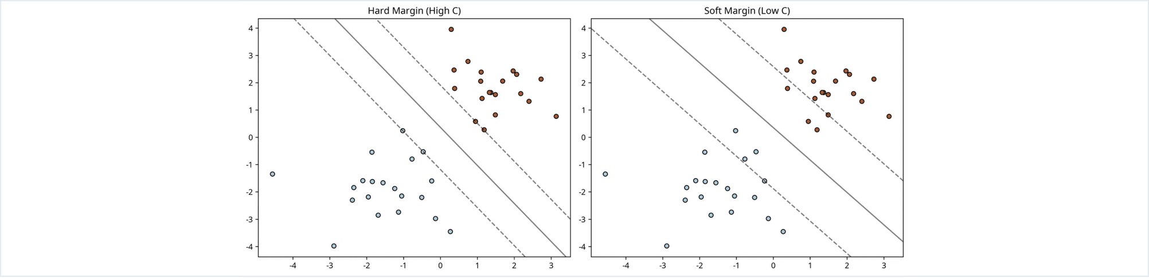
Hard Margin vs. Soft Margin
Hard Margin SVM
Soft Margin SVM
Designed for perfectly linearly separable data. It has zero tolerance for misclassification, which can lead to overfitting in the presence of noise or outliers.
The real-world standard that introduces slack variables to allow some misclassifications. This flexibility results in a more robust model that generalizes better.

Slide 5
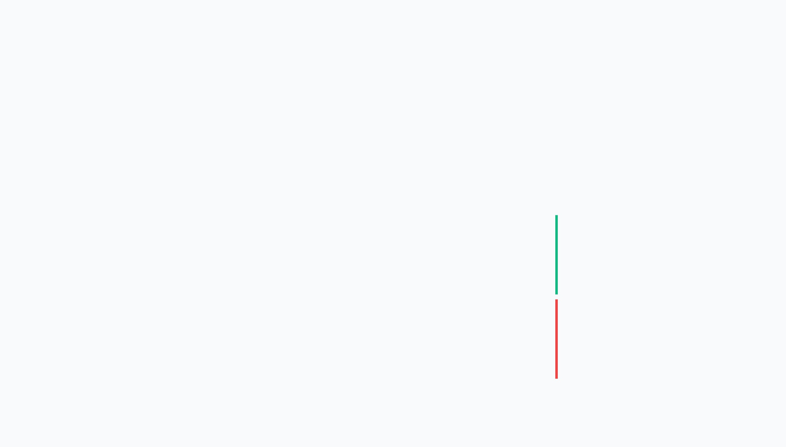
Mathematical Representation
The Hyperplane Equation
^{T}
x + b = 0
w
Positive Class (+1)
Weight Vector (w)
Bias (b)
Defines orientation; perpendicular to the decision boundary.
Specifies the offset from the origin for shifting the boundary.
w
^{T}
x + b > 0
Negative Class (-1)
w
^{T}
x + b < 0

Slide 6
Optimization and Constraints
The Optimization Goal
Classification Constraints
Maximize Margin
Combined Constraint
Maximize 2 / ||w||
y
(w
^{T}
x
+ b) ≥ 1
_{i}
_{i}
Equivalent to:
Minimize ||w|| / 2
To find the Maximum Margin, we optimize the weight vector w. Minimizing the norm of w effectively pushes the marginal planes as far apart as possible.
This constraint ensures that every data point
x
_{i}
is correctly
classified and lies
outside or exactly on
the marginal planes.
For support vectors, the equality holds:
y
_{i}
(w
^{T}
x
_{i}
+ b) = 1

Slide 7
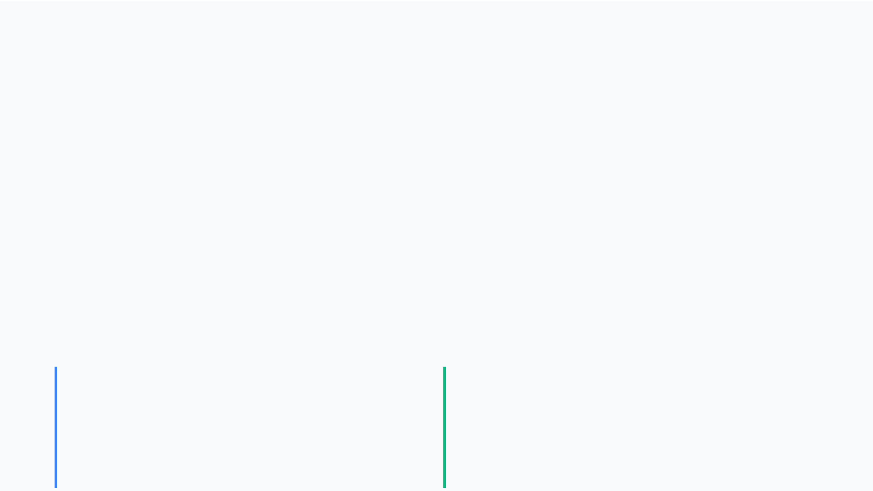
Handling Errors with Slack Variables
Slack Variable (ζ)
The Cost Function
Minimize: ||w||/2 + C Σ
Introduced in Soft Margin SVM to measure the distance of misclassified points from their correct marginal plane. It allows the model to handle non-linearly separable data by tolerating specific errors.
ζ
_{i}
Regularization Parameter (C)
A hyperparameter that controls the trade-off between maximizing the margin and minimizing classification errors.
High C (Harder Margin)
Low C (Softer Margin)
• Prioritizes minimizing misclassifications • Results in a narrower margin • Risk of overfitting to noise
• Prioritizes a larger margin width • Allows more misclassifications • Better generalization for new data

Slide 8
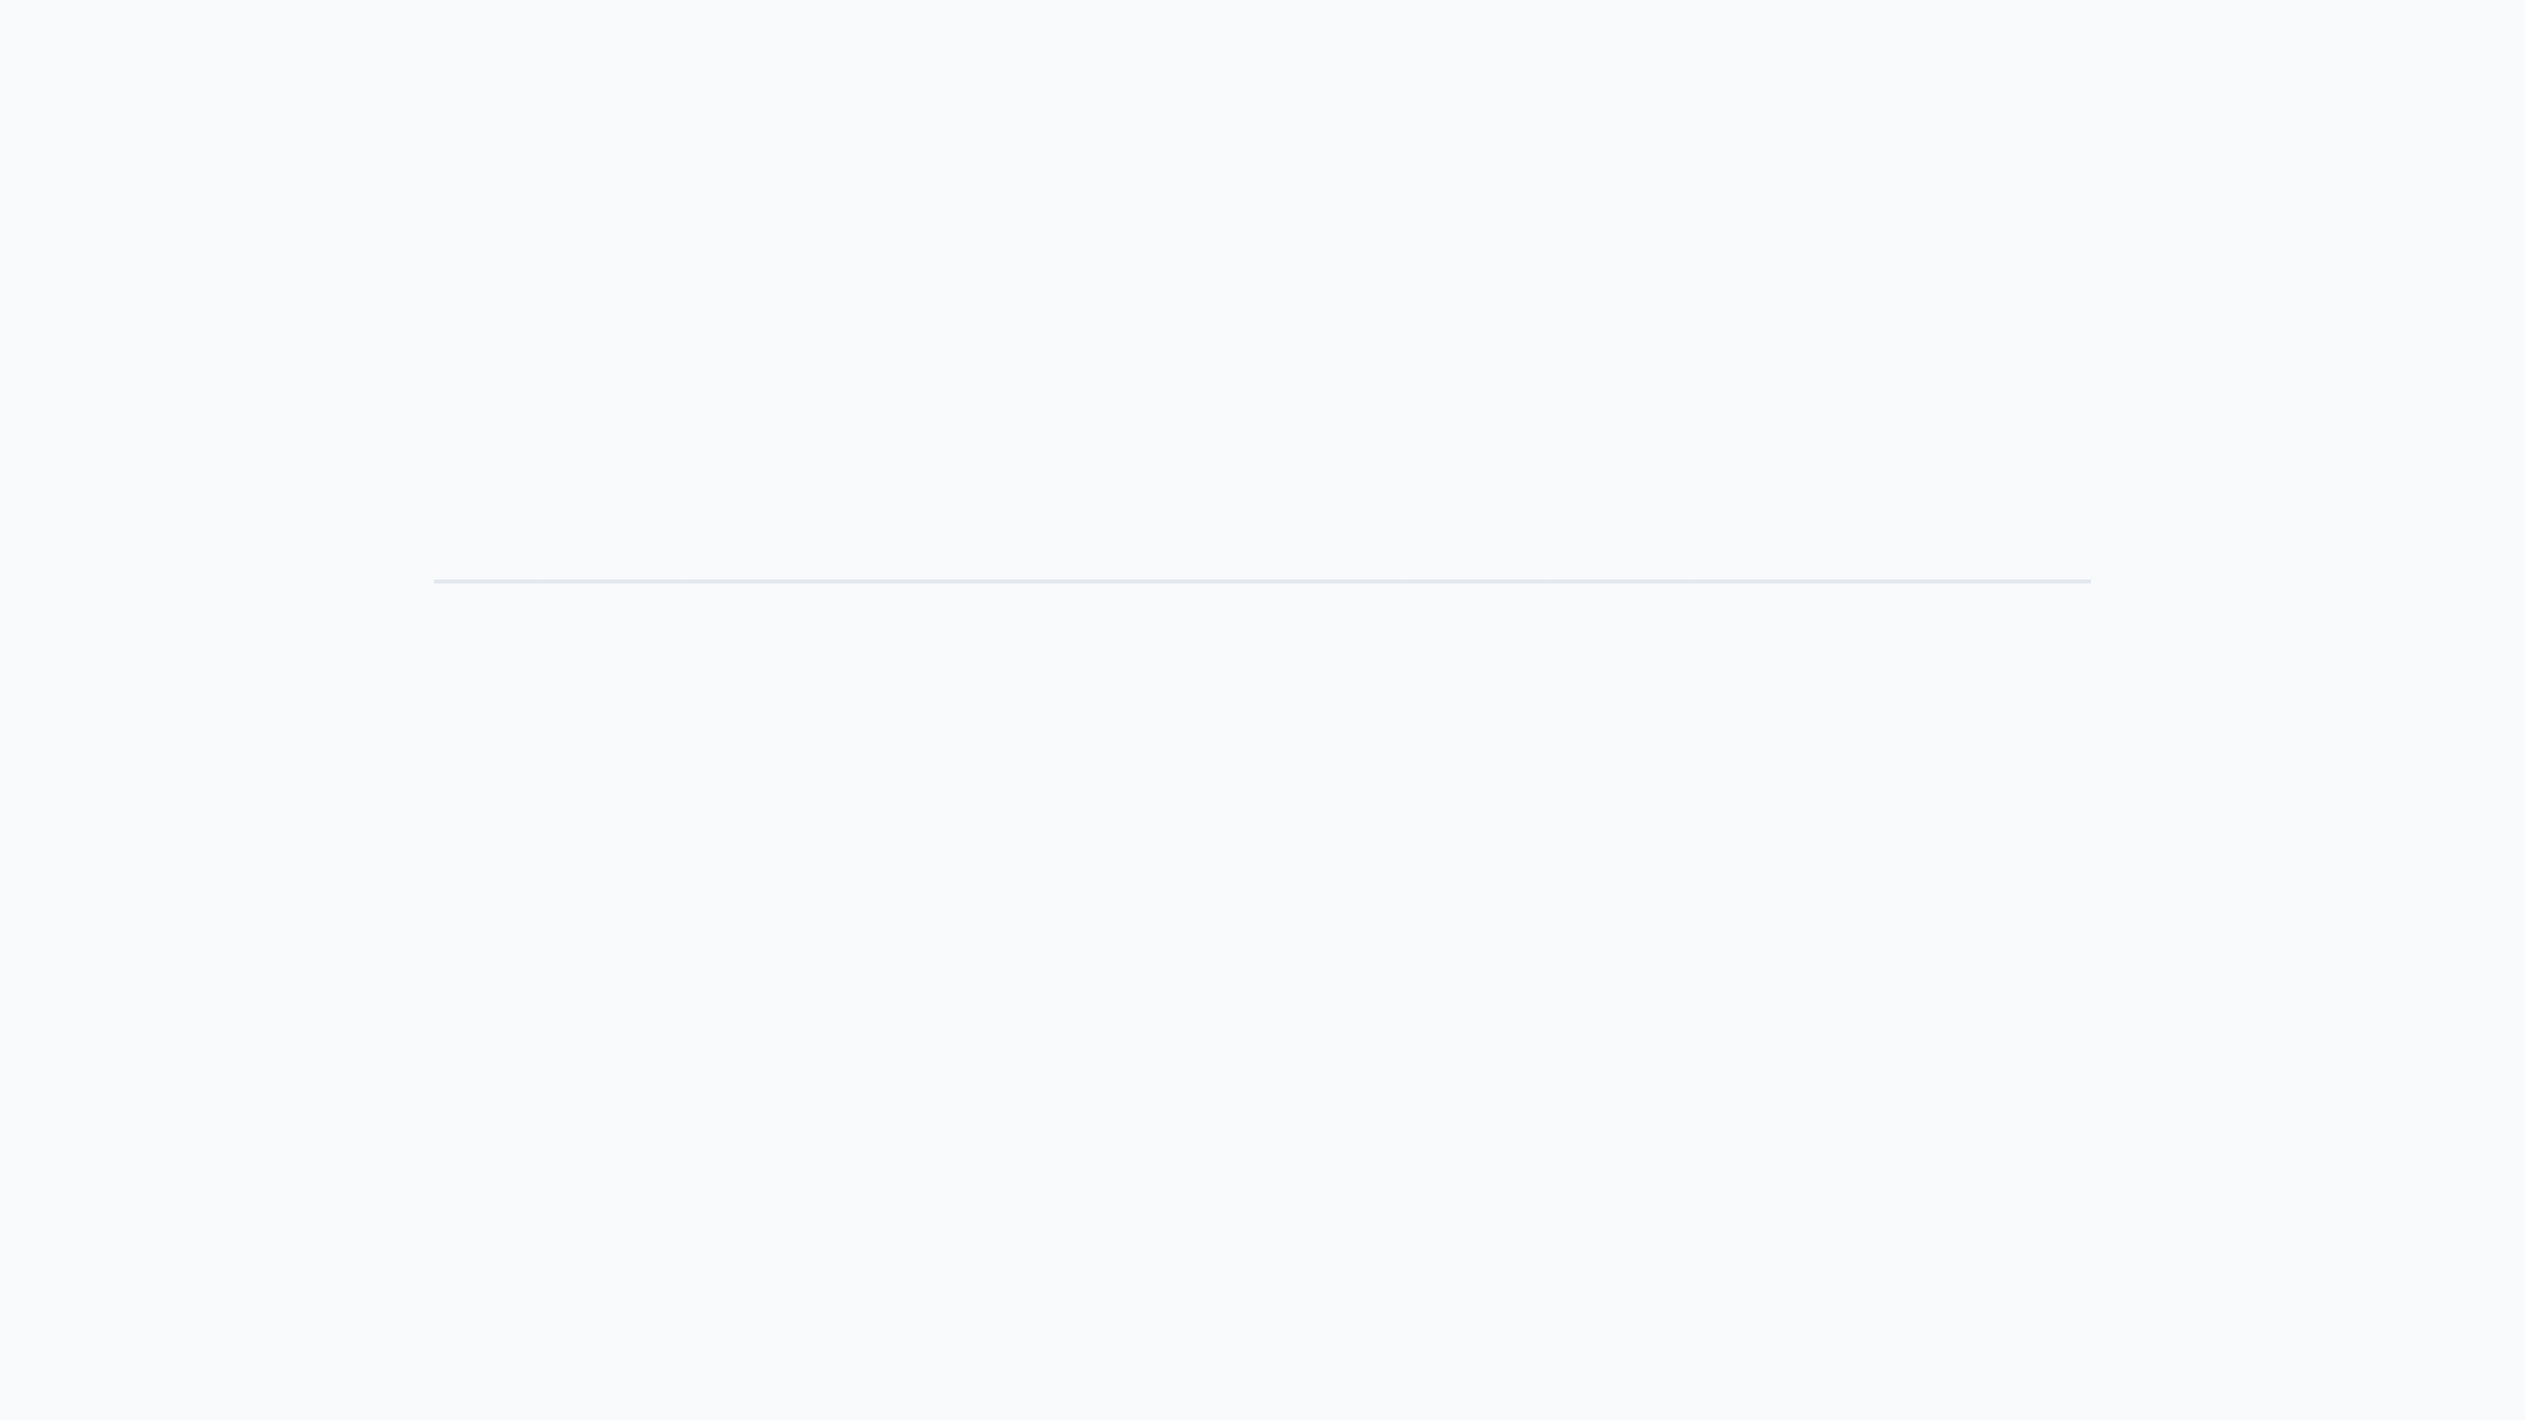




The SVM Process Summary
1
2
3
4
Identify Support Vectors
Construct Margins
Optimize Hyperplane
Predict & Classify
Draw parallel marginal planes passing through the identified support vectors.
Calculate the central line that maximizes the distance between margins.
Use the resulting model to classify new, unseen data points with high confidence.
Locate the nearest data points from each class that define the boundary.

Slide 9
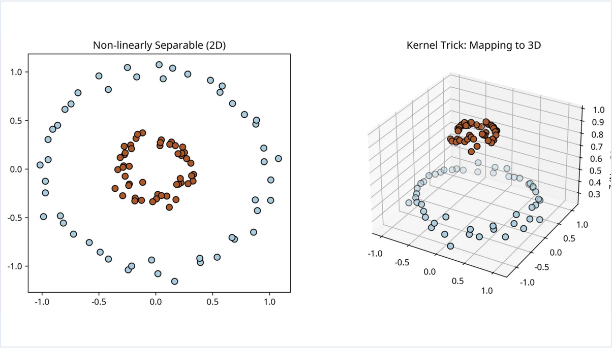
Advanced Concepts: The Kernel Trick
Non-Linear Separability
Many real-world datasets cannot be separated by a straight line in their original 2D or 3D space.
Higher Dimensions
The Kernel Trick maps data into a higher-dimensional space where a linear hyperplane can effectively separate the classes.
Computational Efficiency
It enables complex classification without explicitly computing coordinates in very high dimensions, saving resources.

Slide 10
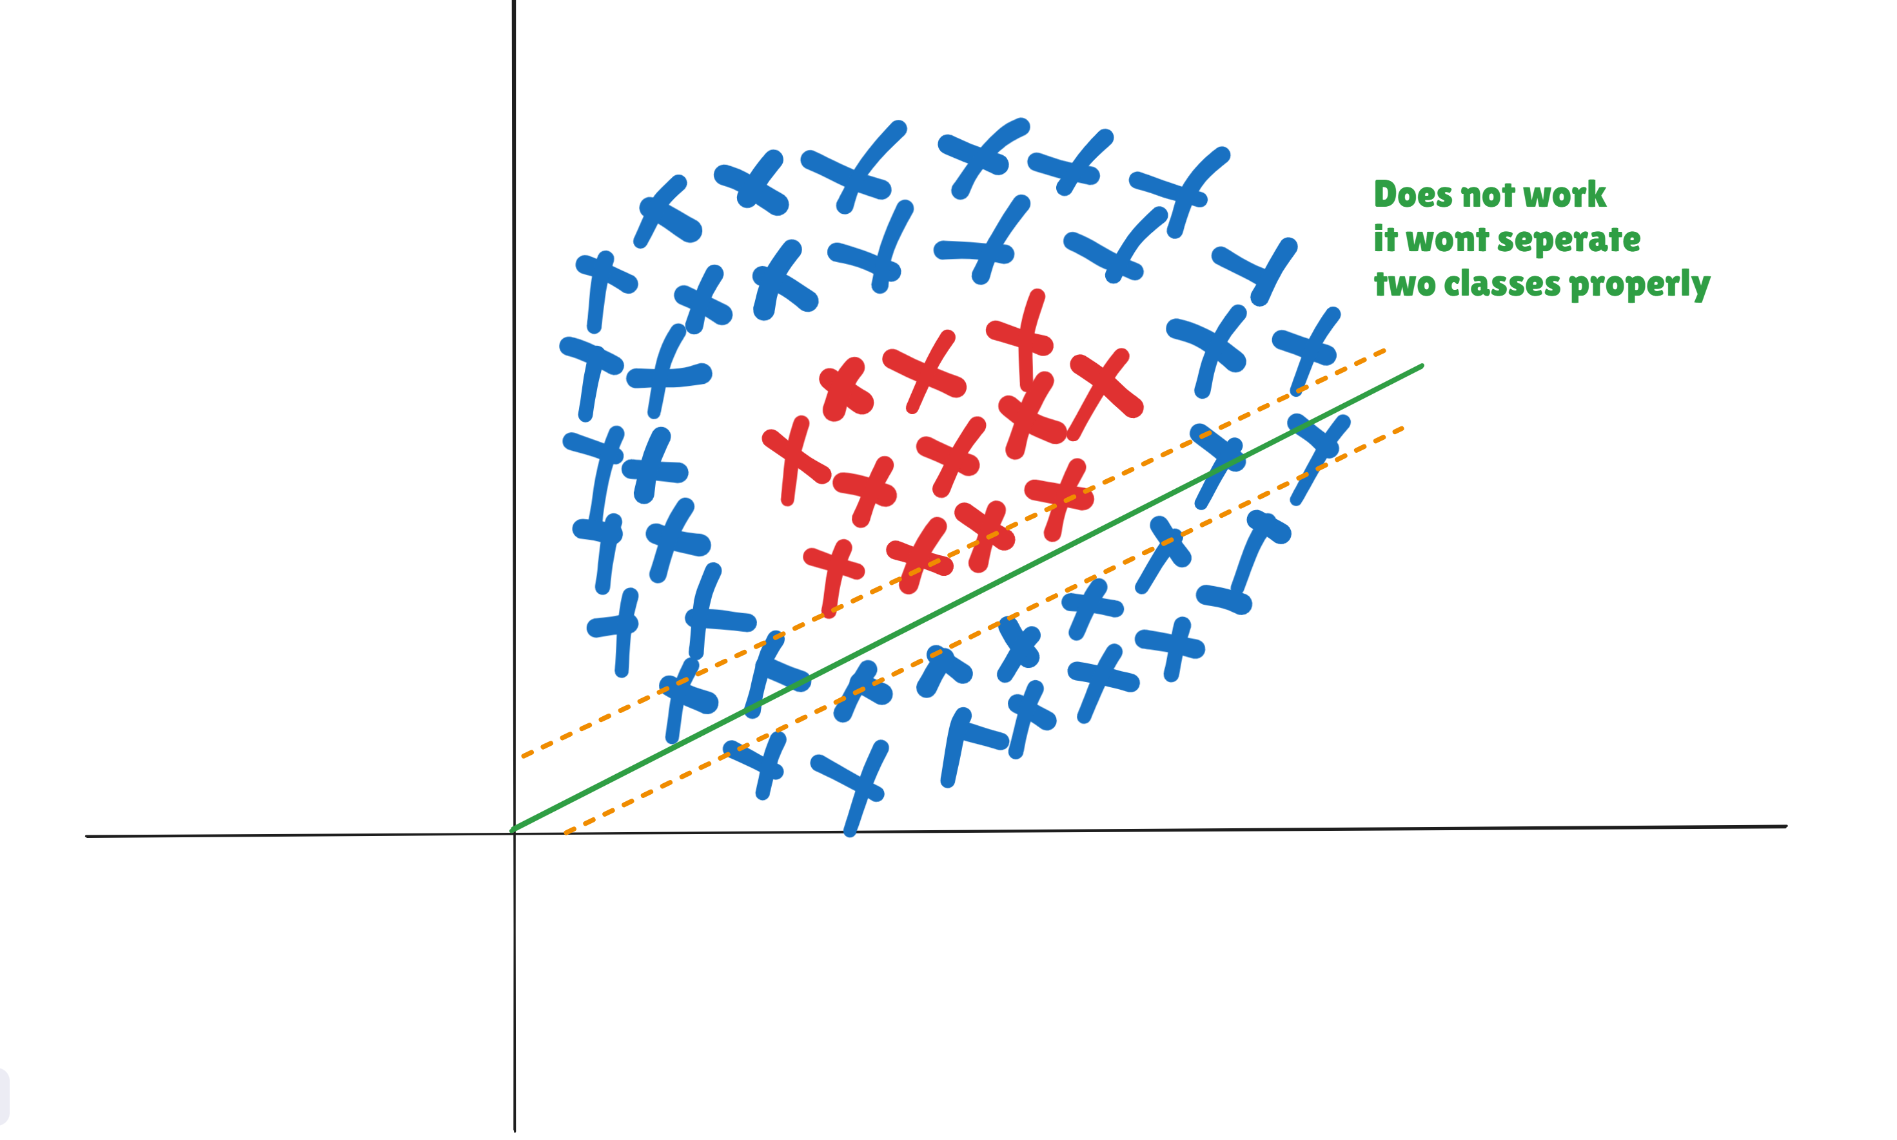

Slide 11
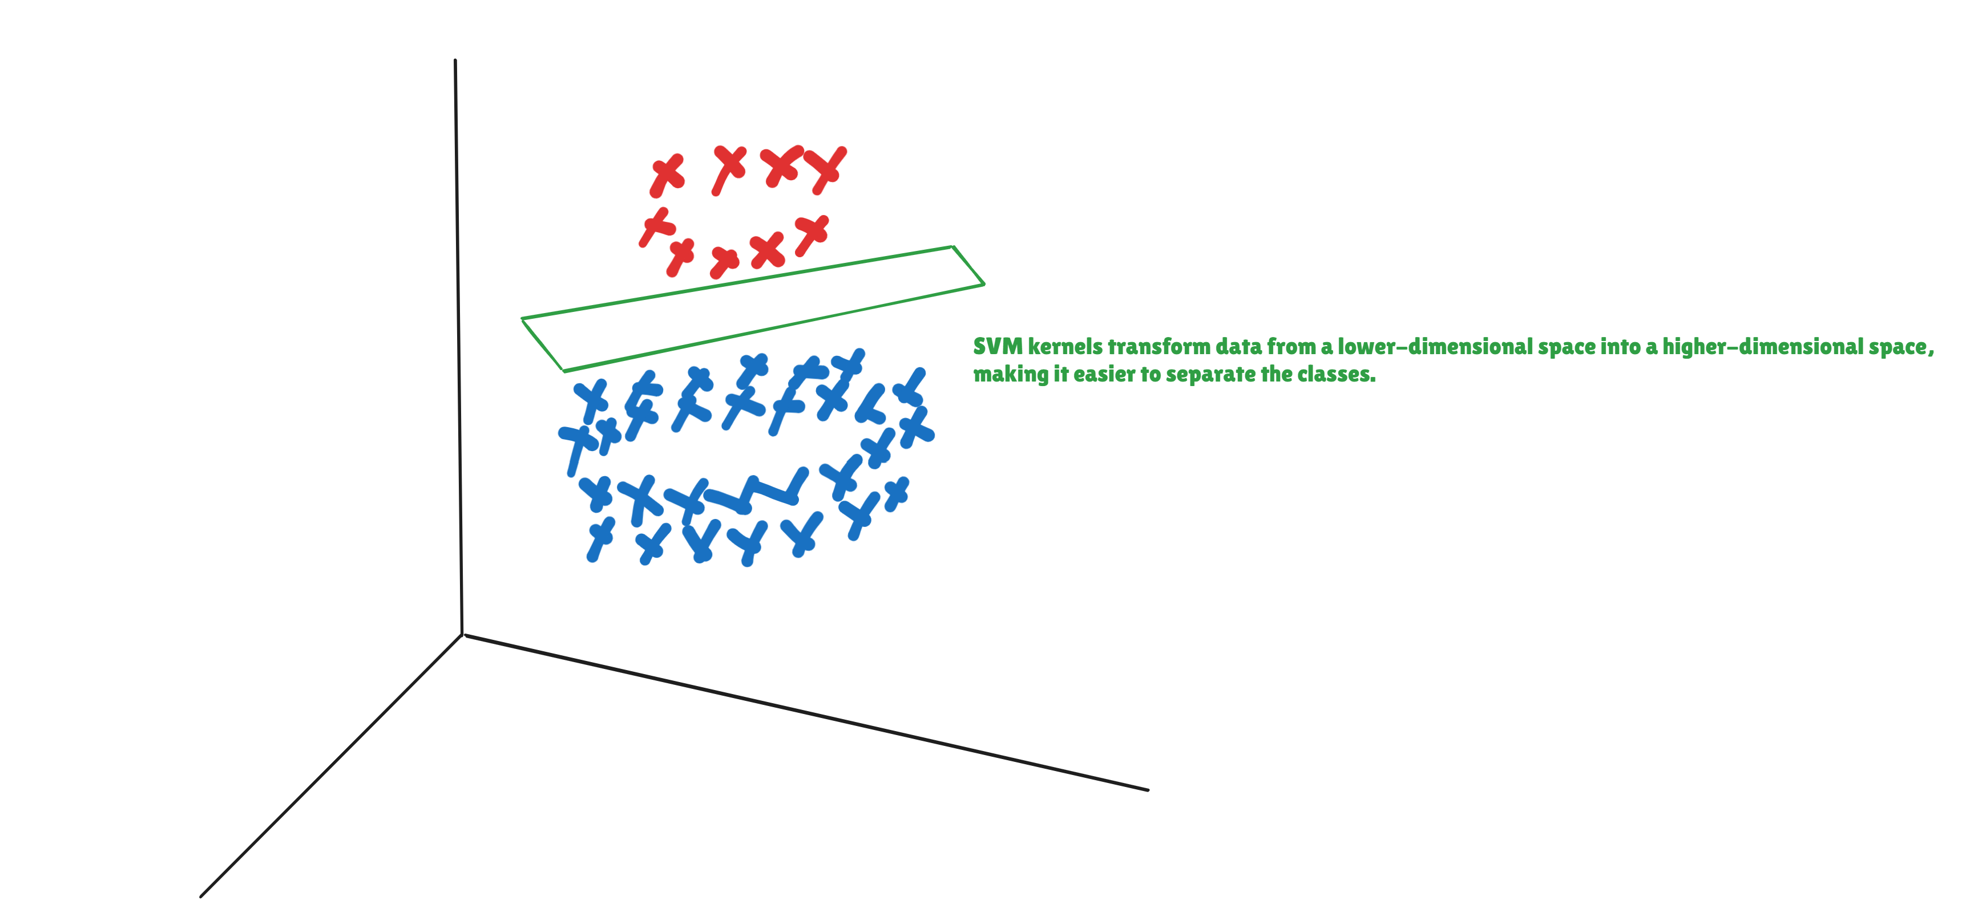

Slide 12
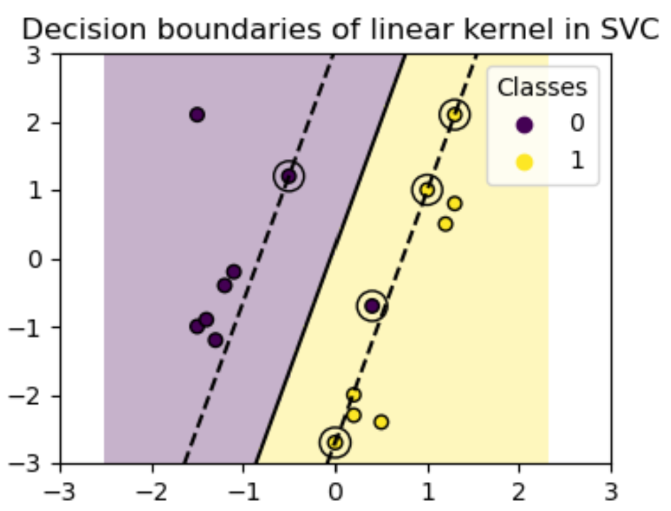
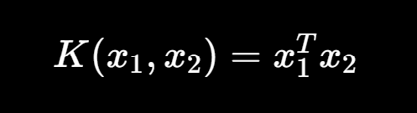
Linear Kernal
Linear kernel is used when the data is linearly separable. It means that data can be separated using a single line. It is one of the most common kernels to be used.
The Formula

Slide 13
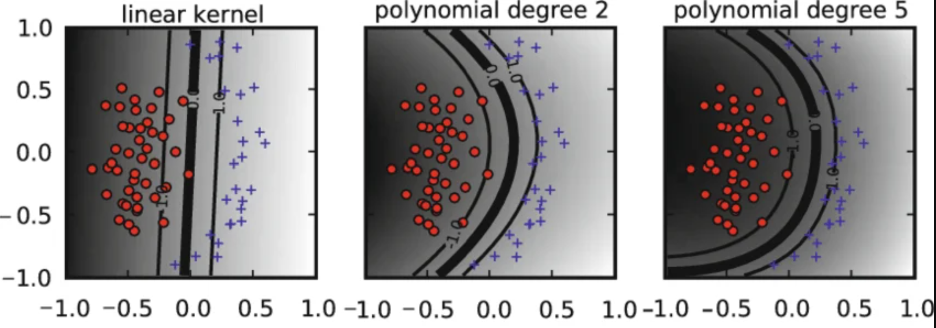
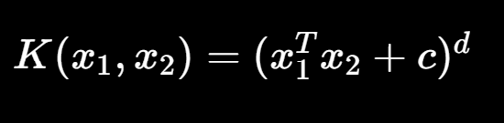
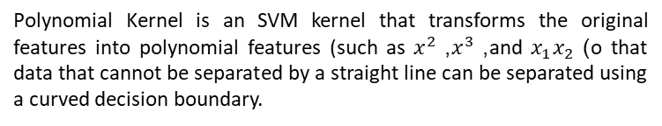
Polynomial Kernel
Polynomial Kernel is an SVM kernel that transforms the original features into polynomial features (such as $x^{2}$, $x^{3}$, and $x_{1}x_{2}$) o that data that cannot be separated by a straight line can be separated using a curved decision boundary.
The Formula

Slide 14
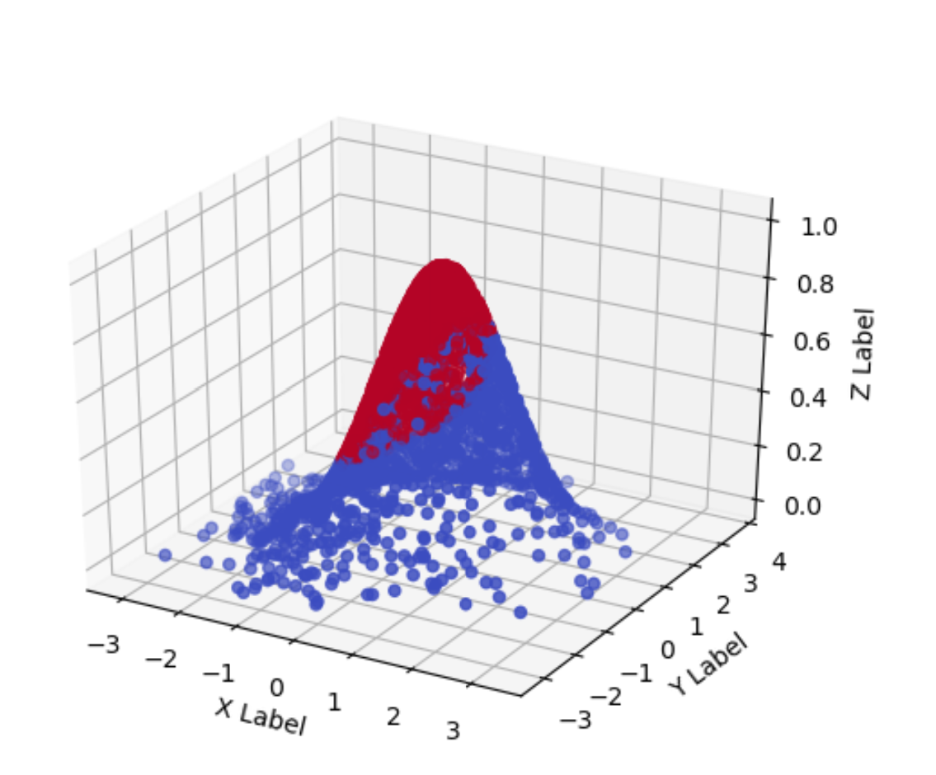
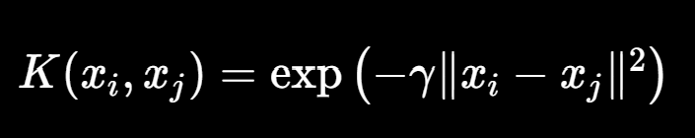
Radial Basis Function Kernel
Radial basis function kernel is a general purpose kernel. It is used when we have no prior knowledge about the data.
The Formula

Slide 15
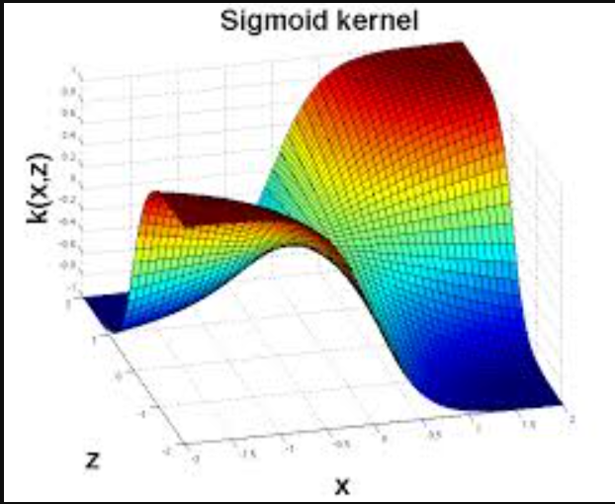
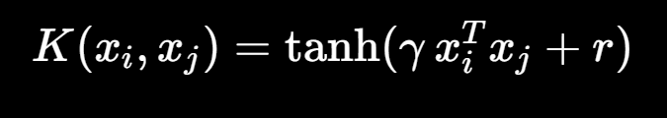
Sigmoid kernel
The Sigmoid kernel applies a sigmoid (S-shaped) transformation to the dot product of two data points, enabling SVM to capture non-linear patterns in the data.
The Formula

